Slide 1
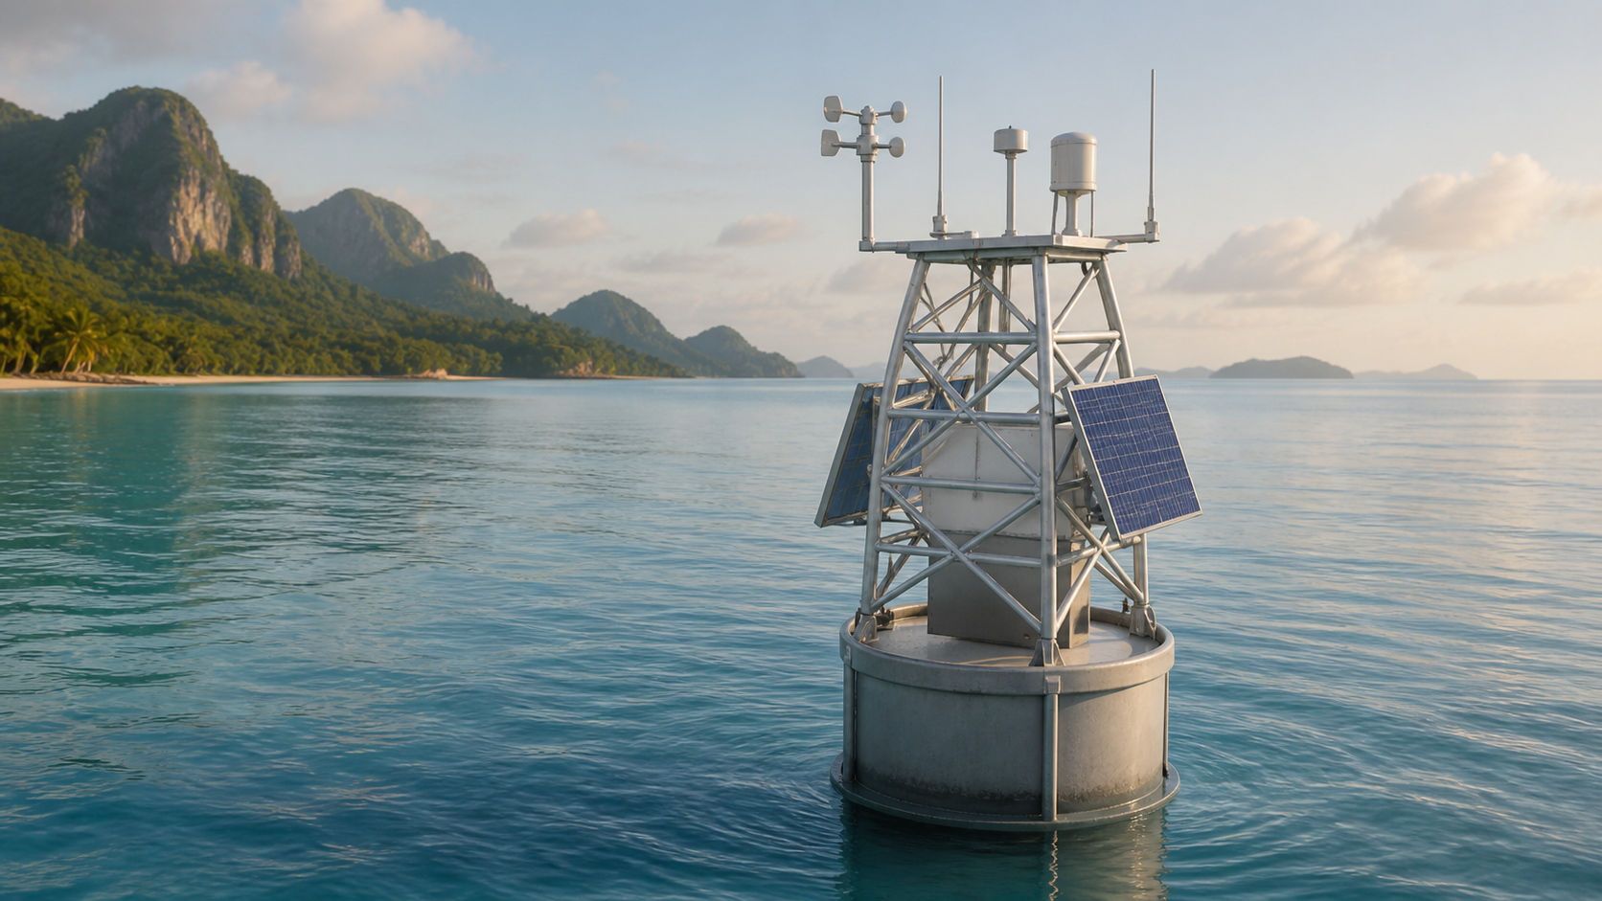
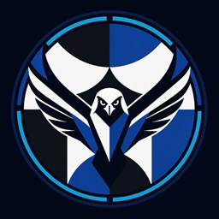
PROJECT FALCON
Fullbright College's AI-powered
Live Coastal Observation Network
An affordable solar-powered smart buoy for localized coastal monitoring, edge processing, and responsible short-horizon prediction research.
IDEA • SOFTWARE PROTOTYPE • FUNDING PROPOSAL
CONCEPT VISUALIZATION
Notes:
Good day, everyone. We are the Project FALCON Research Group from Fullbright College. Project FALCON is our proposed smart buoy for observing coastal conditions in one specific location. In simple terms, it is a floating device with sensors, a small computer, solar power, and a dashboard. It will collect information near the deployment site and show the data in an easier form. Today, we will explain the problem, our proposed solution, what already works in software, and what we still need to build and test.

Slide 2
WHY THIS MATTERS
02
The gap is affordable, site-specific coastal observation
⌖
Localized conditions
₱
Access and cost
⚠
Operational limits
A wide-area forecast may not describe the exact near-shore research or launch site.
Professional oceanographic systems can be difficult for small institutions to acquire and maintain.
Connectivity, power, maintenance, and equipment displacement complicate continuous monitoring.
THE RESEARCH QUESTION
Can a modular, local-first buoy provide useful coastal observations at a defined Palawan pilot site—at a cost and complexity a small institution can manage?
PROJECT FALCON • FULLBRIGHT COLLEGE
DOST IDEA PRESENTATION
Notes:
Why is this project needed? We already have official forecasts, and we respect them. FALCON will not replace PAGASA or any official warning system. Our concern is that a forecast for a large area may not describe the exact condition at a small near-shore site. Professional monitoring equipment can also be expensive and difficult for a school or small local organization to maintain. So our question is simple: can we build a more affordable buoy that provides useful information for one selected pilot site in Palawan?

Slide 3
PROPOSED SOLUTION
03
A local-first smart coastal observation buoy
◉
Measure
Motion, water pressure, wind, GPS, temperature, battery and solar.
▣
Process locally
ESP32 reads sensors; Orange Pi stores, processes, serves the API, and hosts the dashboard.
⌁
Display and alert
UPPER ELECTRONICS POD
Responsive dashboard presents live values, history, system health, and abnormal displacement alerts.
↗
Research prediction
CONCEPT VISUALIZATION
Actual interactive model available: FALCON-01.glb
Field data will be collected before the model is trained, compared with a baseline, and validated.
PROJECT FALCON • FULLBRIGHT COLLEGE
DOST IDEA PRESENTATION
Notes:
Our proposed solution is a smart coastal buoy with four basic jobs. First, the sensors measure movement, water pressure, wind, location, temperature, and available power. Second, the ESP32 gathers the sensor readings, while the Orange Pi saves and processes them. The Orange Pi is simply the small onboard computer of the buoy. Third, the dashboard shows the information through numbers, graphs, history, and alerts. Fourth, after collecting enough real data, we will study whether the system can estimate wave height several minutes ahead. For now, the prediction is only a simulated research demonstration and not yet a real operational forecast.

Slide 4
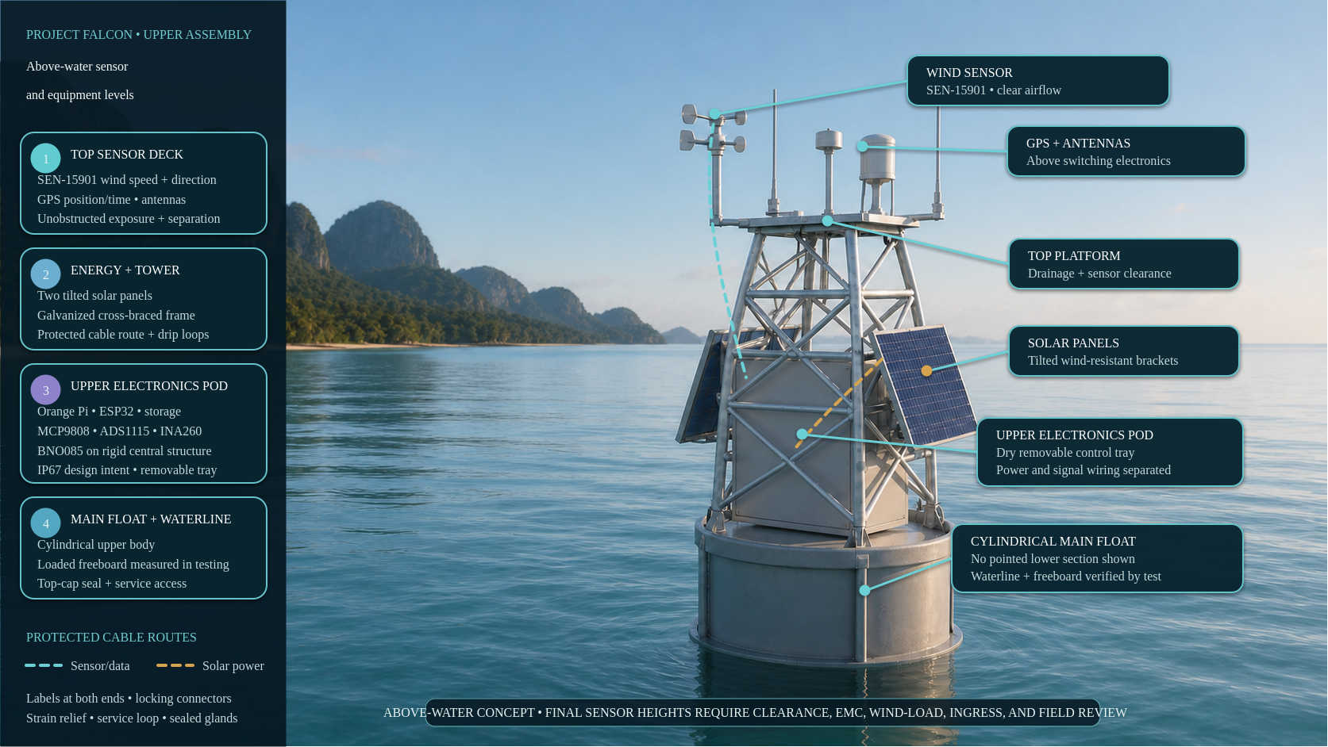
Notes:
This image shows the parts above the water. At the top are the wind sensor, GPS, and antennas because they need open space to work properly. The solar panels are mounted on the tower and provide energy for the system. The large box in the middle is the upper electronics pod. Ito po ang dry and protected box where we plan to place the ESP32, Orange Pi, storage, and other electronic boards. The motion sensor is attached to a rigid part of the structure so it measures the movement of the buoy itself. The round body at the bottom is the main float that keeps the structure above water. Its final balance and waterline will still be tested using the physical prototype.

Slide 5
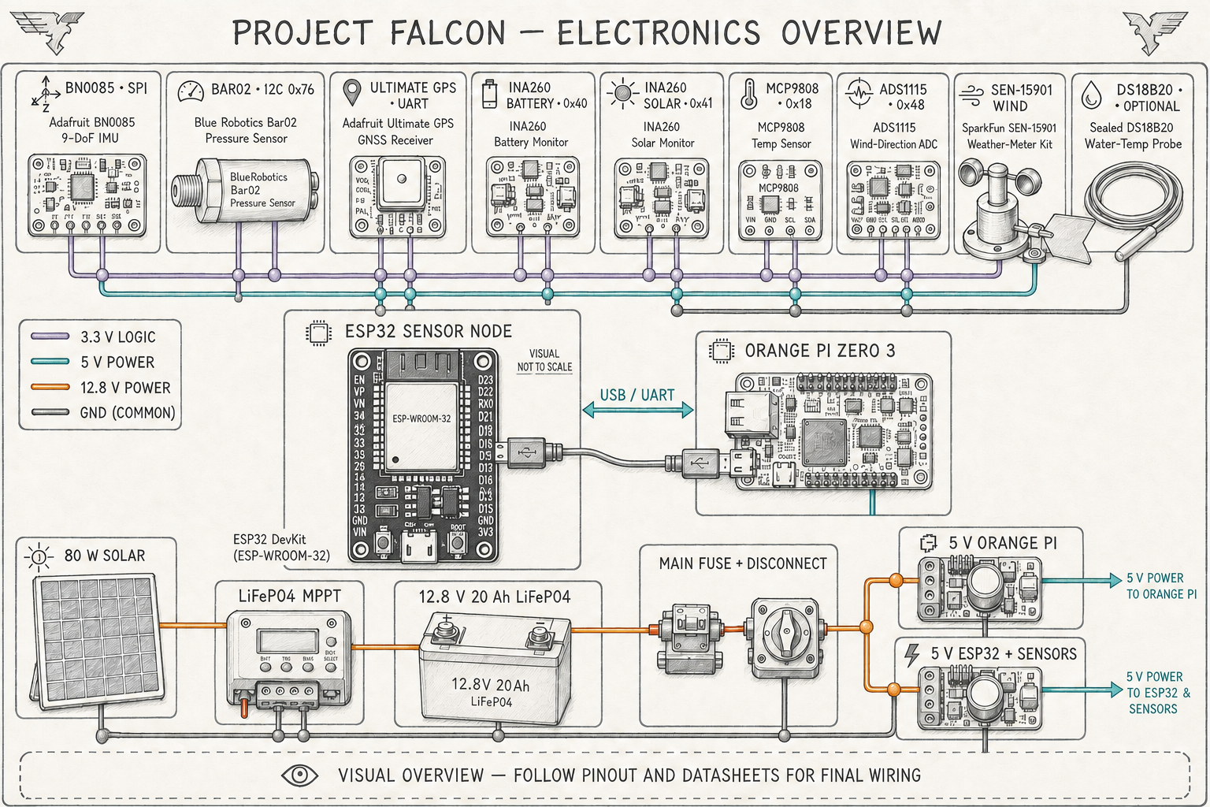
HARDWARE CONCEPT
05
Selected sensors, controllers, and protected power flow
Visual overview only • final wiring follows purchased-board datasheets and the approved pinout.
PROJECT FALCON • FULLBRIGHT COLLEGE
DOST IDEA PRESENTATION
Notes:
This diagram explains the job of each electronic component. The BNO085 measures the tilt and movement of the buoy. The Bar02 measures water pressure, which may help us estimate wave movement after proper calibration. GPS tells us the location, while the wind sensor measures wind speed and direction. The INA260 boards check the battery and solar power, and the MCP9808 checks the temperature inside the electronics box. All sensor readings go first to the ESP32. The ESP32 then sends the data to the Orange Pi for storage, processing, and display on the dashboard. The lower section shows how solar energy charges the battery and safely supplies power to the electronics. This is still a design guide; we will confirm the exact wiring using the real boards and their official datasheets.

Slide 6
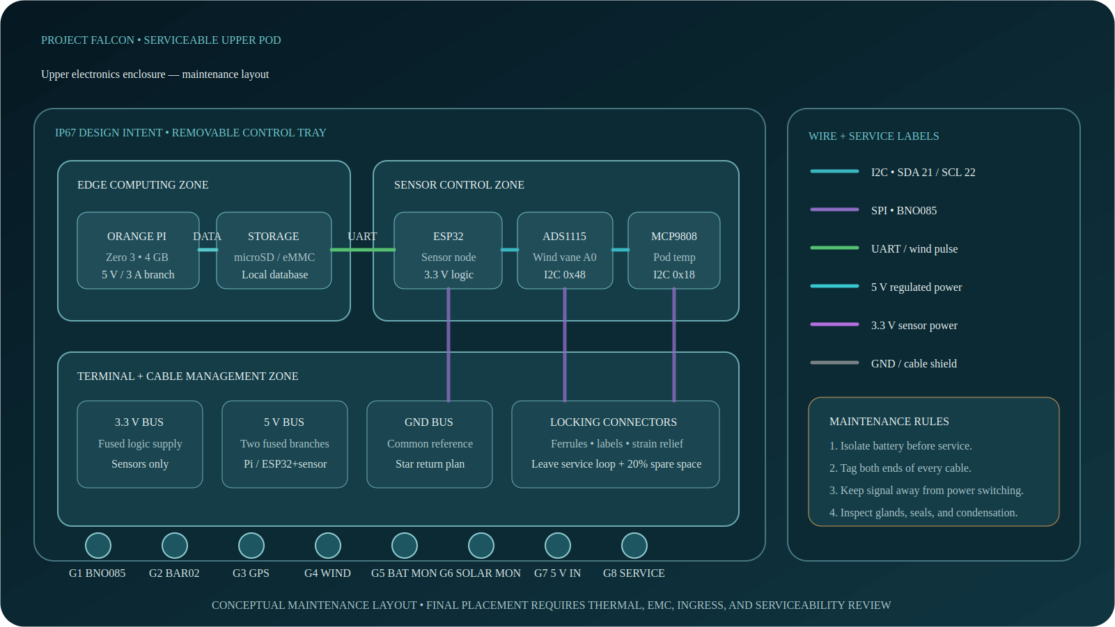
MAINTAINABLE ENCLOSURE
06
The upper pod organizes electronics and labeled cables
PROJECT FALCON • FULLBRIGHT COLLEGE
DOST IDEA PRESENTATION
Notes:
This slide shows how we plan to arrange the electronics inside the upper box. The parts will be mounted on a removable tray, so we can inspect or replace them without removing the whole buoy structure. The Orange Pi side handles computing, while the ESP32 side handles sensor reading. Terminal blocks keep the wires organized instead of leaving many loose connections. Each cable will have a label on both ends, and cables entering the box will pass through waterproof locking glands. We will also separate signal wires from power wires to reduce electrical interference. Before actual deployment, we still need to test heat, waterproofing, wire clearance, and ease of maintenance.

Slide 7
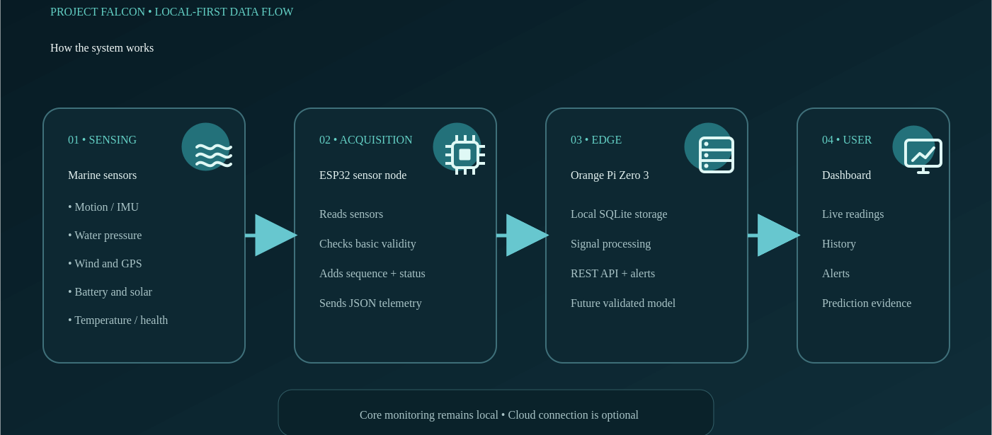
SYSTEM WORKFLOW
07
Sensors measure; ESP32 collects; Orange Pi explains
PROJECT FALCON • FULLBRIGHT COLLEGE
DOST IDEA PRESENTATION
Notes:
This slide shows the flow of information. First, the sensors take measurements. Next, the ESP32 collects and checks those readings. It sends them to the Orange Pi as telemetry, which simply means organized sensor data. The Orange Pi saves the data, performs calculations, checks possible alerts, and sends the results to the dashboard. The dashboard then presents the information as readable values, graphs, and status messages. We call this local-first because the main processing and storage happen inside the buoy system, even without a continuous internet connection.

Slide 8
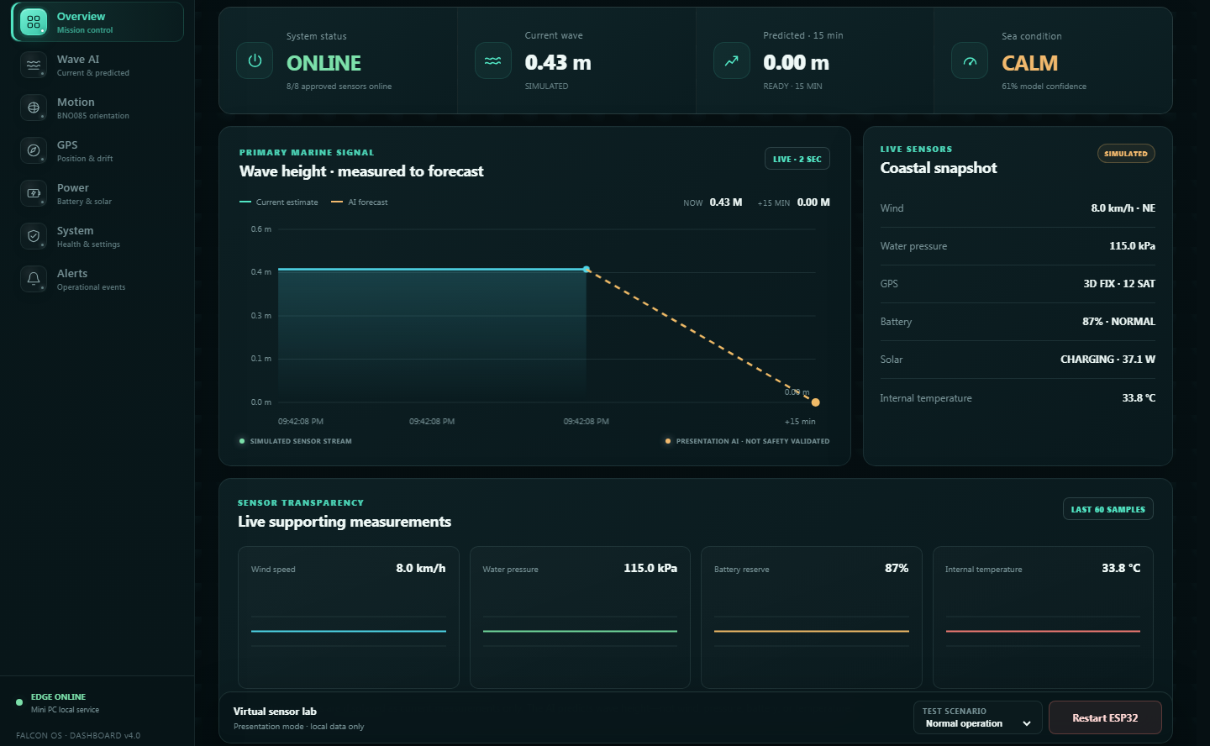
CURRENT PROGRESS
08
A working software concept—not yet a field-validated buoy
✓
Already working
Responsive dashboard
ESP32 firmware foundation
Telemetry contract + simulator
Python edge API + local database
Alerts and documentation
✓
Verified in software
Firmware builds successfully
18 edge-service tests pass
Dashboard production build passes
SIMULATED DATA • NOT FIELD MEASUREMENTS
PROJECT FALCON • FULLBRIGHT COLLEGE
DOST IDEA PRESENTATION
Notes:
What have we finished so far? We already created the responsive dashboard, the basic ESP32 firmware, the data format used by the system, the simulator, the Orange Pi or laptop edge service, the local database, alerts, wiring plans, bill of materials, and project documentation. We also tested whether the firmware, backend service, and dashboard can build and operate in software. However, we want to be honest: the current dashboard data are simulated. They do not yet come from a complete buoy in the sea. Our next stage is to connect the real sensors, calibrate them, build the buoy, and perform supervised field testing.

Slide 9
INNOVATION
09
The contribution is responsible system integration
FALCON does not claim to invent the buoy, sensor, or AI algorithm.
◫
Affordable + modular
⌂
Local-first
◐
Transparent output
Student-scale architecture with replaceable, documented components.
Monitoring and storage continue without mandatory cloud dependence.
Measured, simulated, estimated, and predicted values are clearly distinguished.
FALCON's novelty is the validated integration and local adaptation of sensing, edge computing, energy, prediction, and protection subsystems.
PROJECT FALCON • FULLBRIGHT COLLEGE
DOST IDEA PRESENTATION
Notes:
We are not claiming that we invented the buoy, the sensors, or artificial intelligence. These technologies already exist. Our proposed innovation is how we combine them into one affordable and maintainable system for a specific local use. FALCON joins sensors, local processing, solar-power monitoring, data storage, a dashboard, and a future prediction model. It also clearly labels whether information is measured, simulated, estimated, or predicted. Our contribution will be proven only if the complete system is calibrated and tested for one selected coastal site.

Slide 10
BENEFICIARIES
10
Start with one verified user and one pilot site
⚓
Coastal LGU / DRRM
◒
Fisherfolk / small craft
Localized observation history and equipment-status awareness.
Accessible near-shore information for a defined use case.
⌬
Schools / researchers
◎
Ports / tourism / NGOs
A reproducible platform and local dataset for future studies.
Potential monitoring support after validation and stakeholder confirmation.
PILOT PRINCIPLE: prove value for one stakeholder before expanding scope.
PROJECT FALCON • FULLBRIGHT COLLEGE
DOST IDEA PRESENTATION
Notes:
Several groups may benefit from this project. A coastal LGU or DRRM office may use the observation history and equipment alerts. Fisherfolk or small-boat users may benefit from easier access to information about one nearby site. Schools and researchers may use the platform and collected dataset for future studies. However, we will not claim that one prototype can immediately serve everyone. We will first choose one partner, one pilot location in Palawan, and one specific information need. If the first pilot is useful, the project can be improved and expanded later.

Slide 11
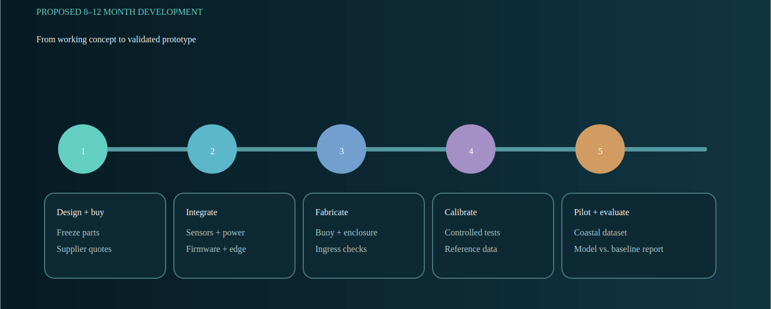
DEVELOPMENT PLAN
11
Build safely, collect evidence, then evaluate
ESTIMATED DEVELOPMENT: 8–12 MONTHS
PROJECT FALCON • FULLBRIGHT COLLEGE
DOST IDEA PRESENTATION
Notes:
Our estimated development time is eight to twelve months. First, we will finalize the design, exact components, safety requirements, and purchasing plan. Second, we will assemble the electronics and fabricate the buoy enclosure and structure. Third, we will calibrate the sensors and test power, waterproofing, and communication in controlled conditions. After those tests pass, we will conduct a supervised near-shore pilot. We will use the collected data to compare our AI model with a baseline, meaning a simple prediction method used as a reference. Finally, we will report the results, errors, limitations, and recommended improvements.

Slide 12
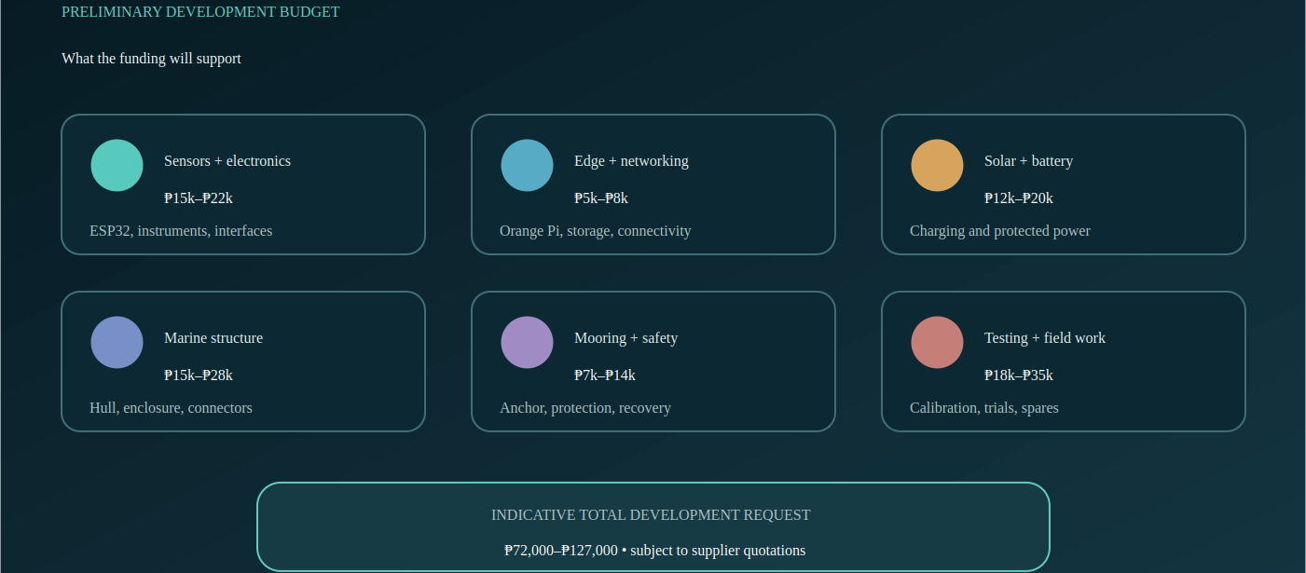
PRELIMINARY BUDGET
12
Funding supports the complete development process
PROJECT FALCON • FULLBRIGHT COLLEGE
DOST IDEA PRESENTATION
Notes:
Our preliminary budget is around seventy-two thousand to one hundred twenty-seven thousand pesos. Why is it a range? Because the exact marine-rated parts, fabrication cost, and supplier prices still need final quotations. The budget includes not only sensors and computers, but also solar power, battery, waterproof enclosure, buoy structure, mooring, safety materials, calibration, field testing, transportation, spare parts, and contingency. In other words, the request covers the complete process of building and testing a safe prototype. Before purchasing, we will submit an updated bill of materials with actual supplier prices.

Slide 13
EXPECTED RESULT + REQUEST
13
Turn the working concept into a validated physical prototype
✓
Deliverables
Integrated physical prototype
Calibrated sensing and power
Local dashboard and data archive
Controlled + supervised coastal results
Model-versus-baseline evaluation
Reproducible technical documentation
→
Support requested
Component procurement • fabrication • calibration access • supervised field testing • technical mentorship
We are asking for the opportunity to generate local evidence—not acceptance of an untested operational forecast.
CONCEPT VISUALIZATION
PROJECT FALCON • FULLBRIGHT COLLEGE
DOST IDEA PRESENTATION
Notes:
If the project receives support, our goal is to produce one complete and documented physical prototype. We will deliver calibrated sensor results, tested solar and battery operation, a working local dashboard, stored coastal data, and supervised pilot-test findings. We will also compare the future AI model with a simple baseline to determine whether AI actually improves the prediction. We are requesting support for the components, fabrication, calibration, field testing, and technical guidance. To be clear, we are not asking you to trust an untested forecast. We are asking for the opportunity to build the system properly and collect evidence that will show whether it works. Thank you, and we are ready for your questions.

